Slide 1

Decentralized Trading Platform
Presented by: Samuel Apakuki Nayacakalou, Flora Zhao, Md Muhasenul Haque

Slide 2
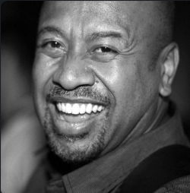
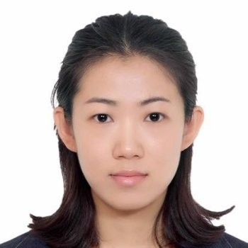

Team 1 Project 3
Samuel Apakuki Nayacakalou, Flora Zhao, Md Muhasenul Haque

Slide 3
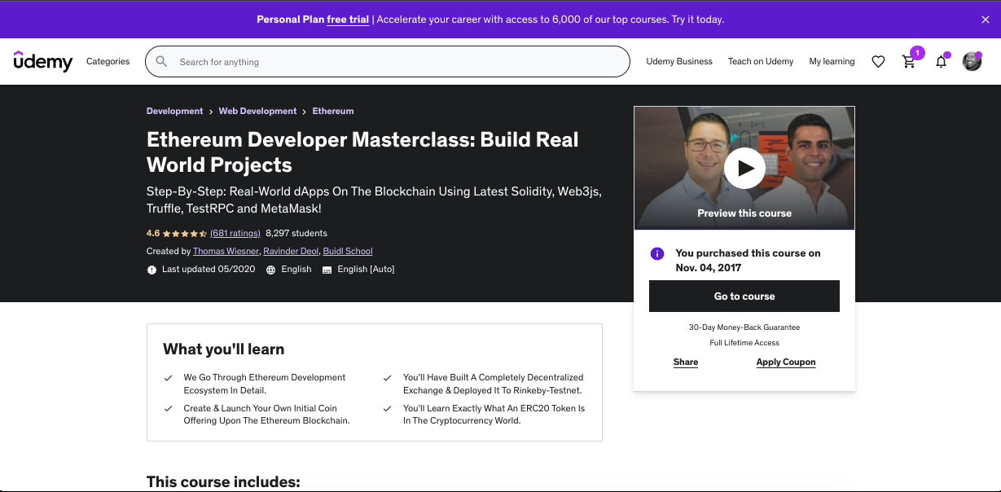
Original Code Base
Original Code: https://github.com/tomw1808/distributed_exchange_truffle_class_3/#

Slide 4
Overview of the Decentralised Exchange (DEX)
Exchange - “An act of giving one thing and receiving another (especially of the same kind) in return.” – Oxford Living Dictionaries
Price, Spread - Demand and Supply make the price (last sell price)
Limit Order – the difference between the lowest ‘ask’ (sell) price, and the highest bid (buy) price creates the market (Market maker). These are called Limit Orders and are entered into the order book
Market Order – An order executed at the current ‘ask’ (sell) or ‘bid’ (buy) price
Volume, Tick Data - First Trade, Highest Trade, Lowest Trade, Last Trade within a time interval

Slide 5
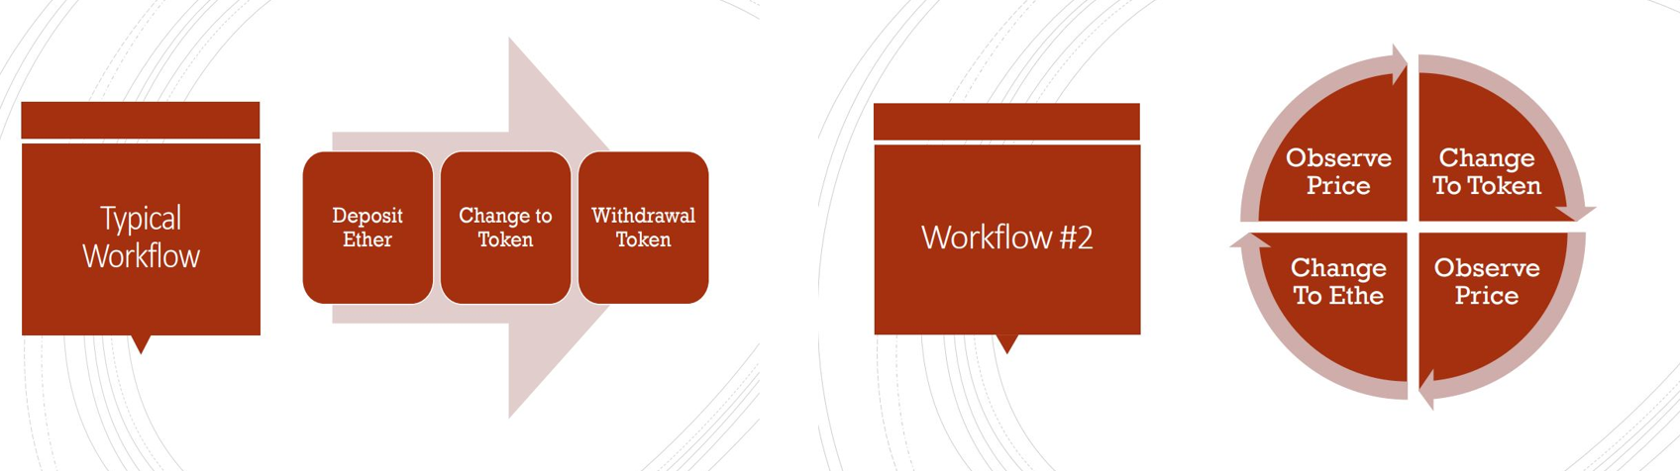
Workflow

Slide 6
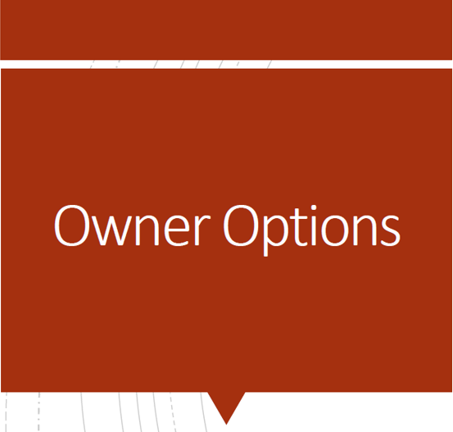
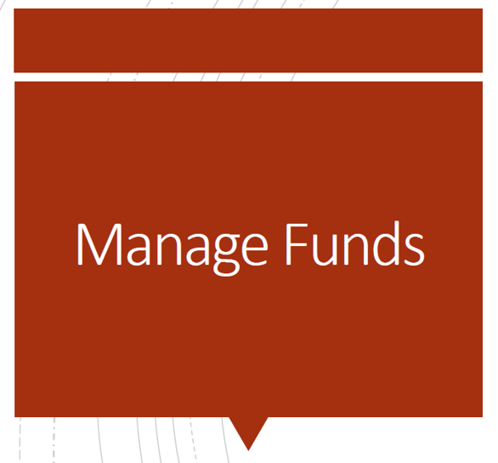

FUNCTIONS OF THE DEX
Admins
Users
Add Token
Deposit / Withdraw Ether
Buy Token / Sell Token
Approve Allowance
Deposit / Withdraw Token
Check Order Book

Slide 7
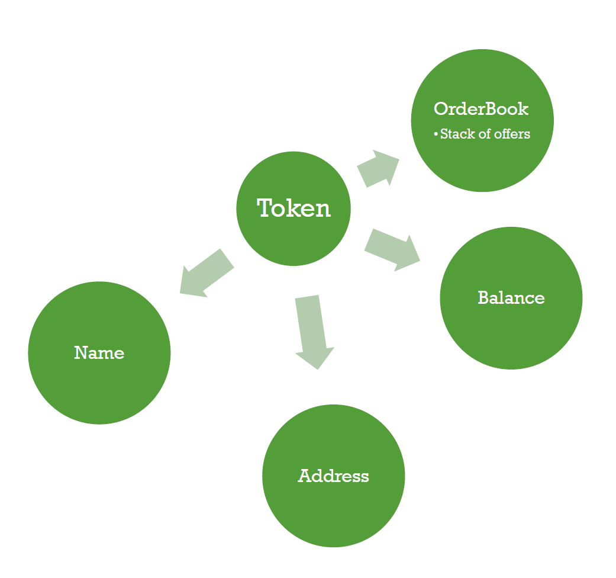
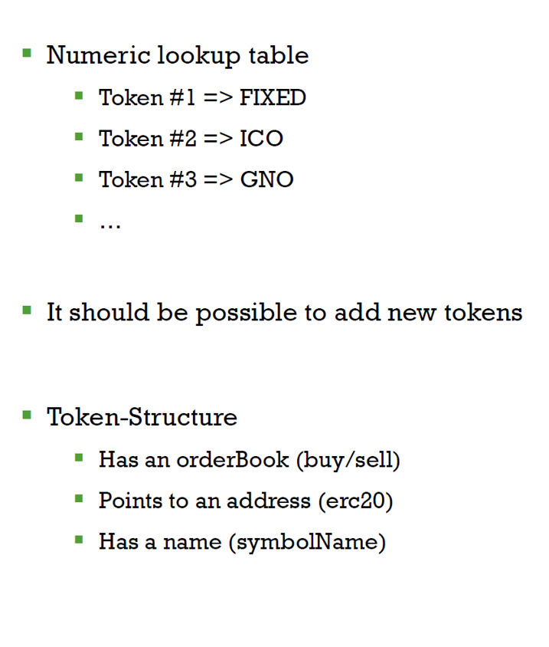
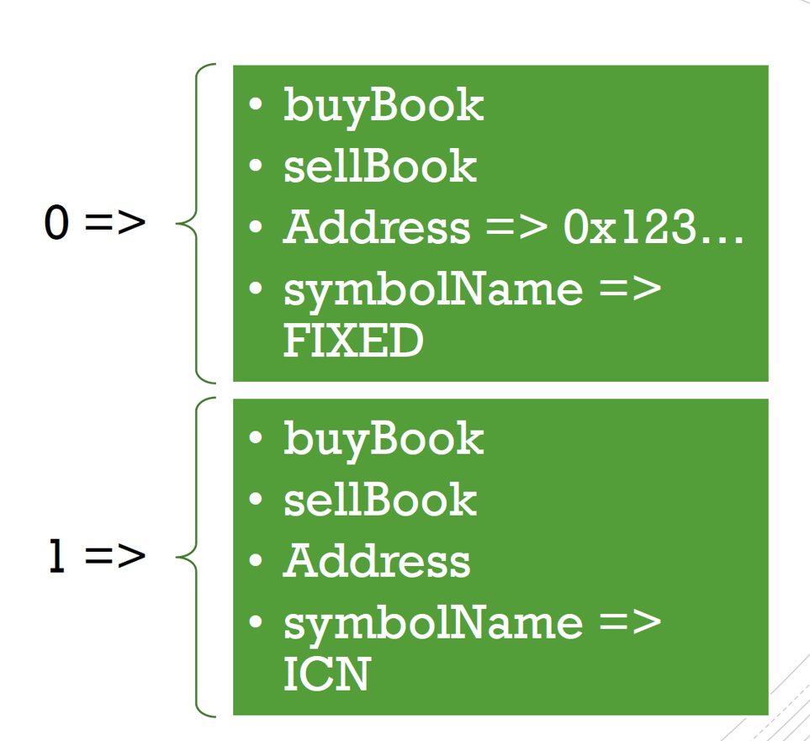
DATA TYPES

Slide 8
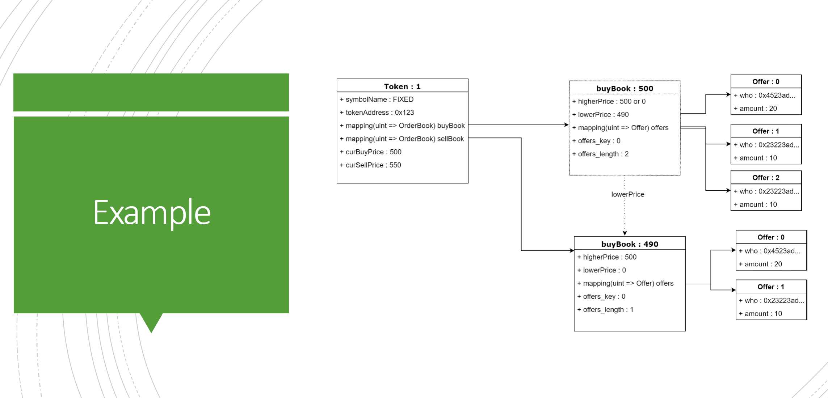
DATA TYPES

Slide 9
FILE STRUCTURE AND DEPLOYMENT
Files
Back End: .env File/.sol File/.json File
Front End: app.py
Readme & PPT
Deployment and Execution
Compile Exchange.sol, FixedSupplyToken.sol
Copy ABI to ‘./compiled/Exchange_abi.json’ and ‘./compiled/FixedSupplyToken_abi.json’
Deploy Smart Contracts: Exchange and FixedSupplyToken
Run app.py: streamlit run app.py

Slide 10
Solidity Code Improvements
Removed deprecated code
Cleaned up function declarations
Improved code security

Slide 11
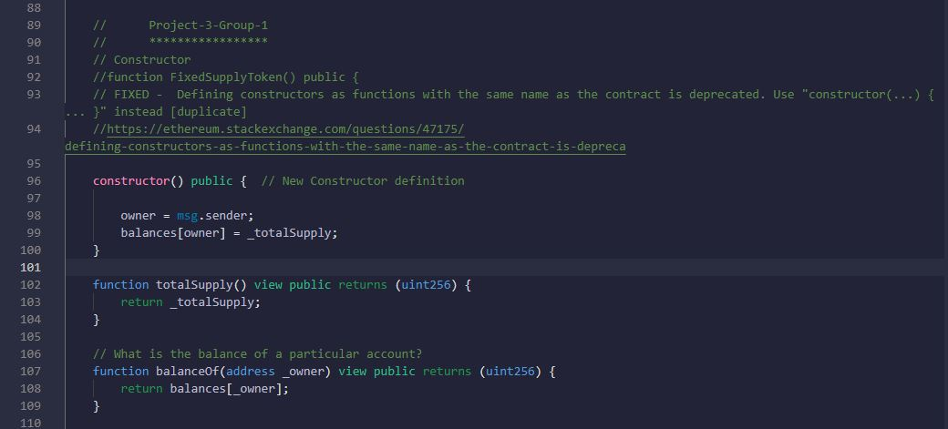
Deprecated Code

Slide 12
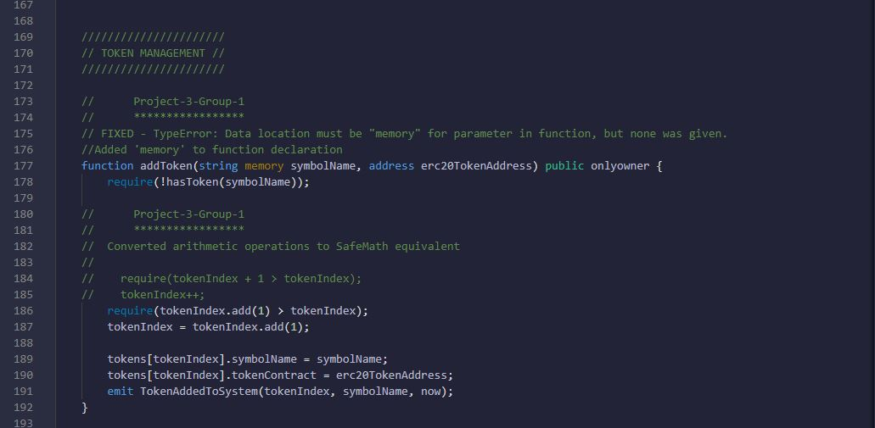
Function Declaration

Slide 13
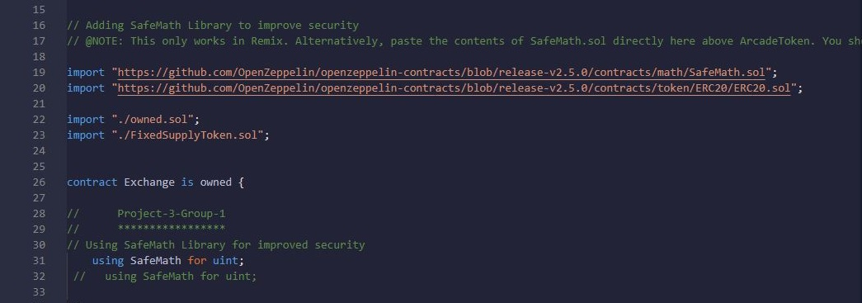
Code Security

Slide 14
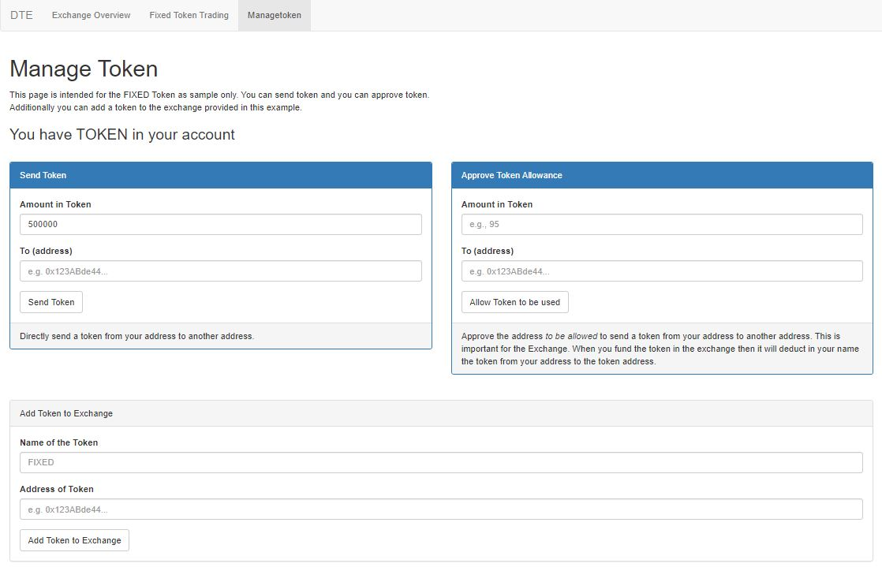
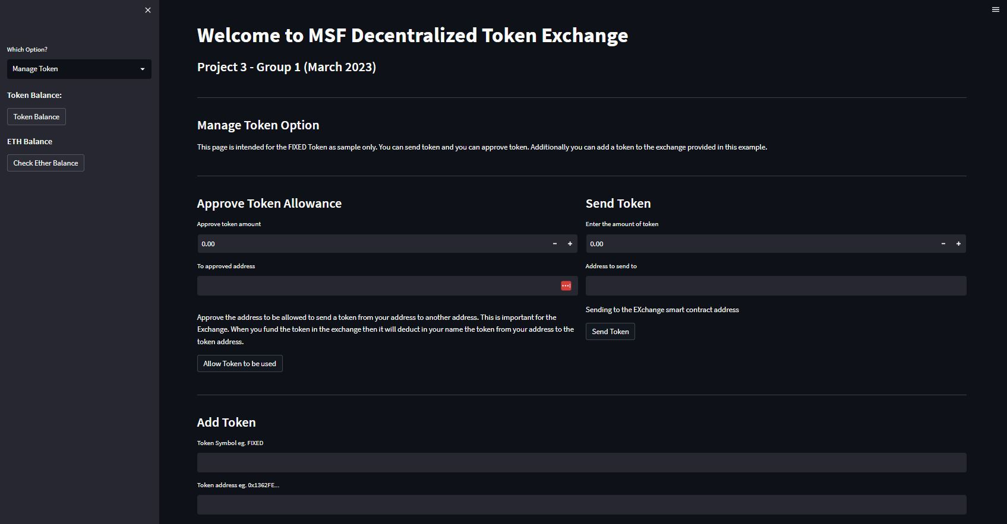
Frontend Comparison

Slide 15
DEMO PROCESS – ADMINS
Add Token to the DEX
Approve Allowance for the DEX to transfer tokens on behalf of the token owner

Slide 16
DEMO PROCESS – USERS – FUND MANAGEMENT
Deposit Ether to the DEX
Withdraw Ether to the DEX
Check Ether balance
Deposit Token to the DEX
Withdraw Token to the DEX
Check Token balance

Slide 17
DEMO PROCESS – USERS – TOKEN TRADING
Buy Tokens
Sell Tokens
Check Order Books (Buy Book and Sell Bood)

Slide 18
FUTURE WORK - DEBUGGING
Order partial fulfilment
CASE 1: buy 5@100 sell 4@100 ERROR
CASE 2: buy 4@100 sell 5@100 WORKING WELL

Slide 19
FUTURE WORK – ADDING NEW FEATURES
Add more than one tokens to the DEX
Cancel Order Function
Emits Events : display more info in the front end or enable the user to check convieniently
Display more info in the front end, e.g. Display the allowance for the owner

Slide 20
FUTURE WORK – UI OPTIMIZATION
Sidebar fonts should be bigger
Some input boxes can be deleted when the functions are optimized

Slide 21
FUTURE WORK – OTHER FRONT END SUPPORTED
Truffle version development to support mobile apps

